Slide 1
Hackathon
Identify New Bikes

Slide 2
Problem Statement: Identify New Bikes
Detailed Description:
1. Display "Upcoming" bikes details like bike name, price and expected launch date in India, for manufacturer 'Honda' & Bike price should be less than 4 Lacs.
2. For Used cars in Chennai, extract all the popular models in a List; Display the same
3. Try to 'Login' with Google, give invalid account details & capture the error message
(Suggested site: zigwheels.com)
Key Automation Scope:
Handling windows & frames
Filling simple form, Capture warning message
Extract menu items from frames & store in collections
Navigating back to home page

Slide 3
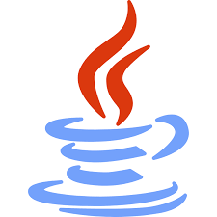

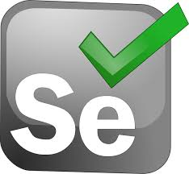

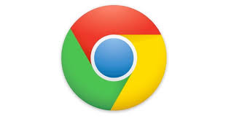


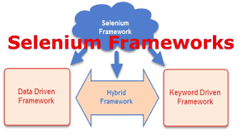



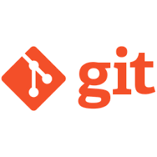


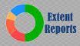





Concepts we have used in our project:
Java
Selenium
Choice of Web Browsers
Hybrid (DataDriven+Keyword driven)
POI
TestNG
Extent Report Logger
Web Page Synchronization
Error/ Exception Handling
Locator Selection Priority
Jenkins
Maven
Conditional Flow
Source Code Management with Git
Code Comments, Naming Conventions, Clean Syntax, Folder Structure

Slide 4
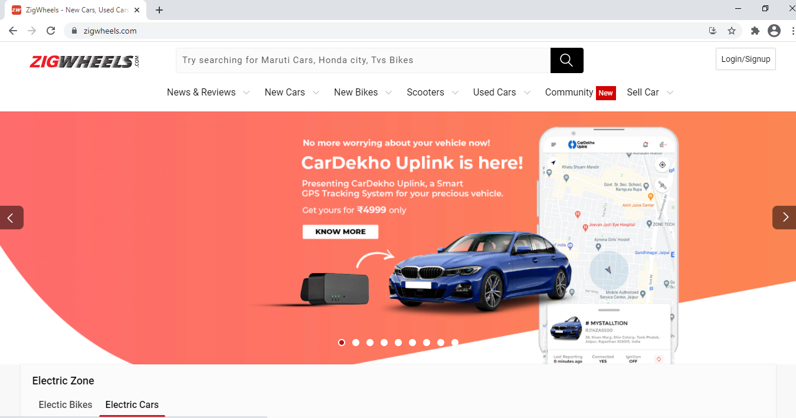
Zigwheels HomePage

Slide 5
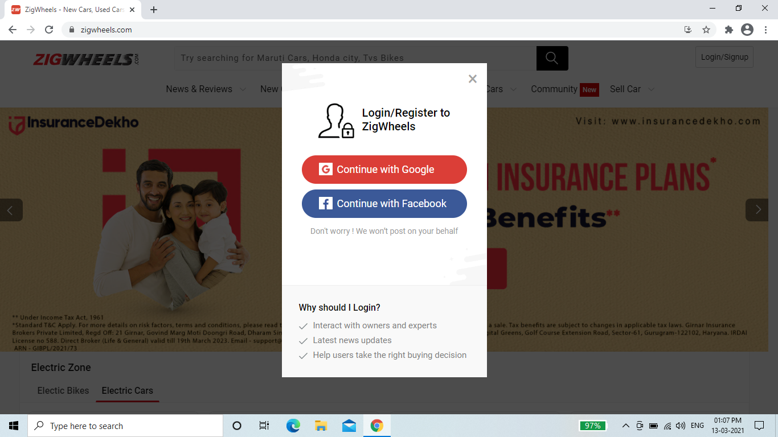
Login Page in Zigwheels

Slide 6
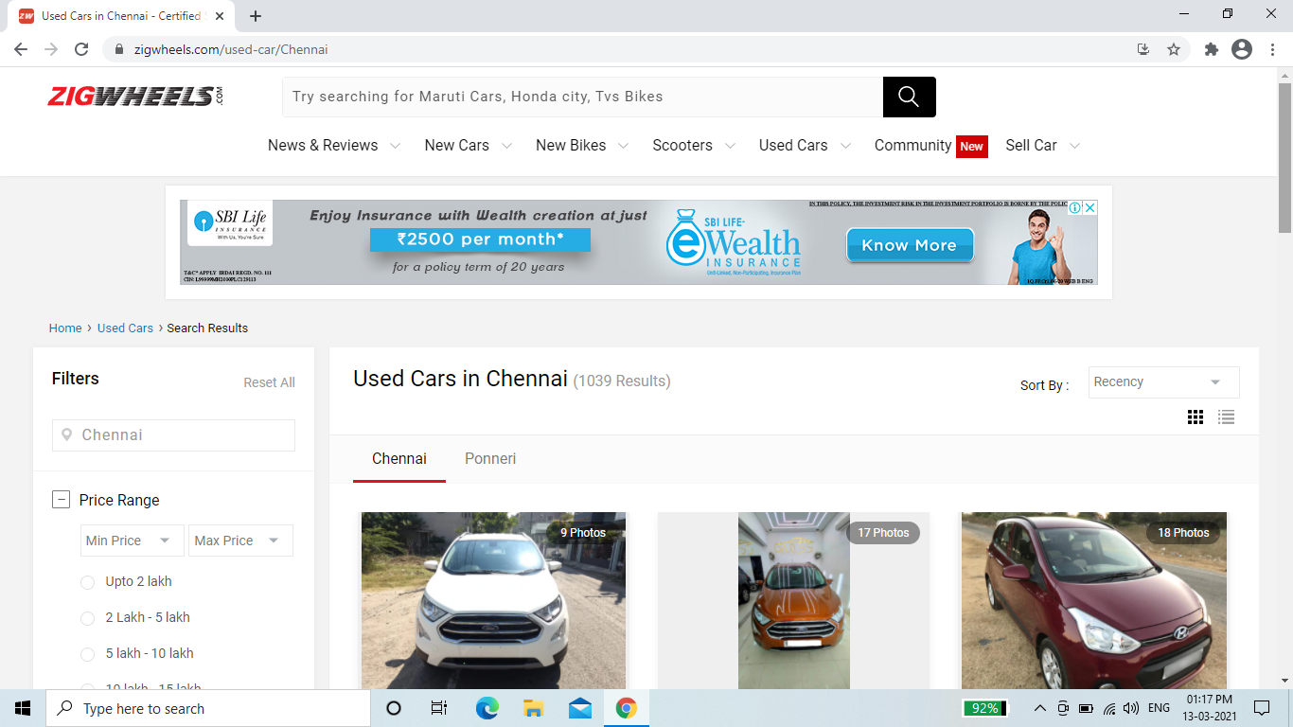
Used Cars

Slide 7
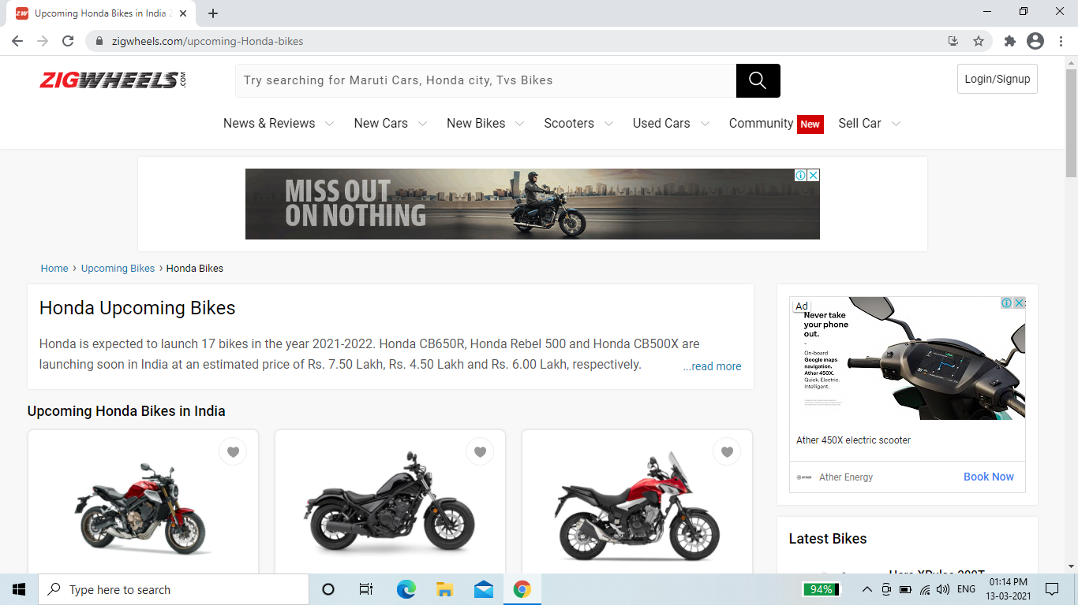
Upcoming Bikes

Slide 8
Selenium
Selenium is a beneficial automation tool because it is not only open source but also a portable software testing framework for web applications .
Selenium provides a playback tool for authoring functional tests without the need to learn a test scripting language(Selenium IDE). It also provides a test domain-specific language to write tests in a number of popular programming languages,
Selenium support multiple languages like Java, C#, Ruby, Python etc.

Slide 9
Maven
Maven is a tool which is used for building and managing dependency for java based projects.
Maven is a project build or project management tool. It is used to check the compilation issues between framework components whenever multiple test engineer integrates their files into the same framework.
Maven can be used when building project with POM (Page Object Model) when working on big projects

Slide 10
TestNG
TestNG is an open source test automation framework for java.
The design goal of TestNG is to cover a wider range of test categories: functional, end-to-end, etc., with more powerful and easy-to-use functionalities.
It also provide some advanced and useful features which makes it a more robust framework as compared to its peers.

Slide 11
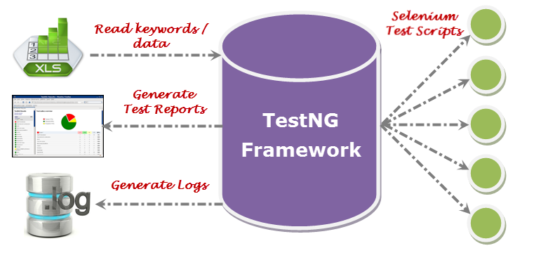

Slide 12
Hybrid Framework
Hybrid Test framework is a concept where we are using the advantage of both keyword and data-driven framework.

Slide 13
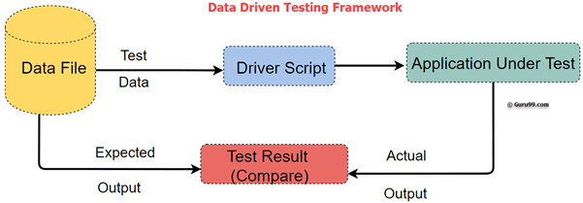
Data- Driven Framework
Data Driven framework is used to drive test cases and suites from an external data feed. The data feed can be data sheets like xls, xlsx, xml, csv files, etc. A Data Driven Framework in Selenium is a technique of separating the “data set” from the actual “test case” (code).

Slide 14
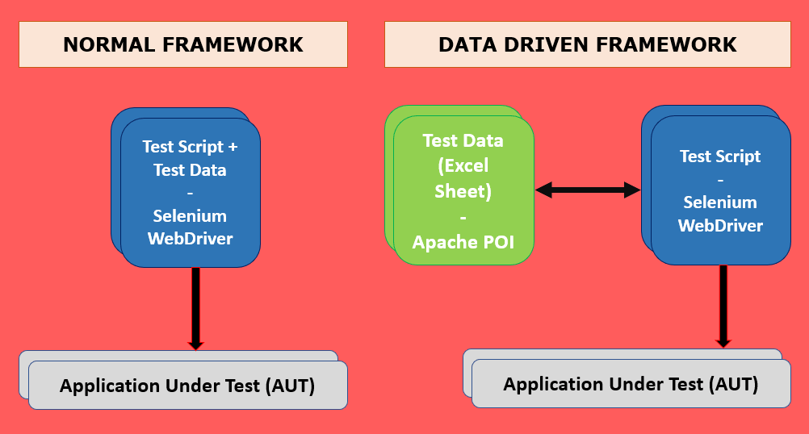

Slide 15
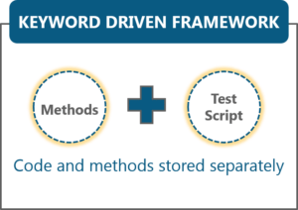
Keyword- Driven Framework
Keyword-driven testing is a type of functional automation testing framework which is also known as table-driven testing or action-word based testing.
It is a method used for speeding up automated testing by separating keywords for common set of functions and instructions. All the operations and instructions to be performed are written in a table format, usually a spreadsheet.

Slide 16
Reports
ExtentReports is an open-source reporting library used for test automation. It is easily integratable with major testing frameworks like TestNG, JUnit, NUnit, etc. These reports are HTML documents that depict results as pie charts. They also allow the generation of custom logs, snapshots, and other customized details.
We have included TestNG reports as well as Extent Reports in our project.

Slide 17
Source Code Management with Git
Source code management (SCM) is used to track modifications to a source code repository. Scm tracks a running history of changes to a code base and helps resolve conflicts when merging updates from multiple contributors. Scm is also synonymous with version control
Git is a free and open source distributed version control system designed to handle everything from small to very large projects with speed and efficienc

Slide 18
Jenkins
Jenkins is an open-source Continuous Integration (CI) server, which automates the build and deploy process of your web applications.
It helps automate the parts of software development related to building, testing, and deploying, facilitating continuous integration and continuous delivery.
By running your Selenium test suite in Jenkins, you can also automate testing as part of the build process.

Slide 19
Thank You!

